Slide 1


Office of the Vice Provost for Educational Equity
Equal Opportunity Planning Committee (EOPC) Funding:
Writing and Submitting a Proposal | Fall 2022
Sheila Barlock, EOPC Administrator

Slide 2

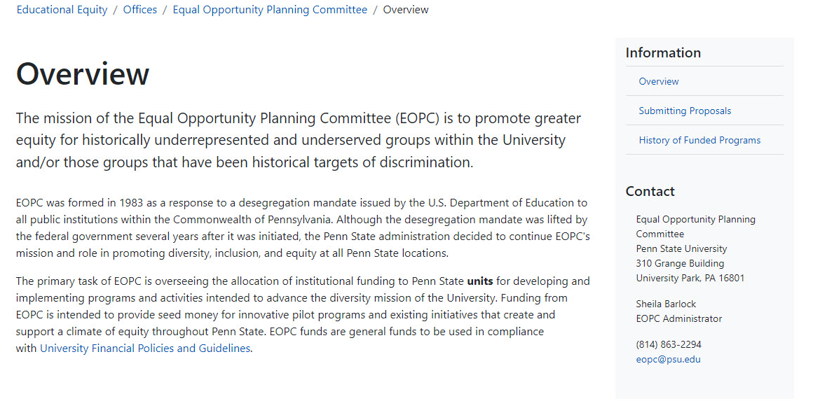
2

Slide 3

What is EOPC?
The Equal Opportunity Planning Committee:
Promotes greater equity for historically underrepresented/underserved groups.
Oversees the allocation of institutional funding.
Provides seed funding for innovative pilot programs (for up to five years). A separate proposal must be submitted each year for consideration.
3

Slide 4

Strategic Planning
All EOPC proposals and funded programs must align with University strategic planning efforts.
https://opair.psu.edu/
https://strategicplan.psu.edu/
https://strategicplan.psu.edu/plan/foundations/inclusion-equity-diversity/
4

Slide 5

EOPC overview:
Sheila D. Barlock, EOPC Administrator
Visit equity.psu.edu for access to the proposal form, tips, and deadlines
Additional proposal resources can be found on the EOPC SharePoint site
Request to be added to the EOPC listserv via eopc@psu.edu
Compliance with University regulations (AD91 Discrimination and Harassment and Related Inappropriate Conduct)
5
5

Slide 6

Focus on EOPC funded initiatives:
Campus climate
Curriculum
Faculty and staff recruiting
Faculty and staff retention
Leadership development
Student recruiting
Student retention and graduation
Organizational change
6
6

Slide 7

Not funded by EOPC:
Gifts, “giveaways,” and prizes
T-shirts, buttons, balloons, and other such items
Conferences where travel is required
Research projects, computer hardware, art, or library collections
Wages/honoraria for 12-month full-time Penn State faculty/staff or graduate assistantships (EOPC will consider funding graduate and/or undergraduate students on wages)
Scholarships
Stipends (students are not eligible to receive stipends)
Instructor salaries for Penn State courses where tuition is charged
Cannot be funded by both EOPC and Campus Access and Success Grants (CASG)
7
7

Slide 8

Assessment as a process:
Goals
Outcomes
Activities
Assessment
Review
8
8

Slide 9

Components of the assessment approach:
Goals: Statements that capture how high-quality work will be measured.
Outcomes: Smaller statements that operationalize the goals.
Activities: Opportunities and experiences that enable specific learning and support outcomes.
Assessment: Activities that help us determine if the desired outcomes were achieved.
Review: How to improve.
9
9
9

Slide 10

Learning outcomes:
If you had to break down goals into discrete components, what would
they address?
Learning outcomes are smaller (in scope) statements that operationalize the goals.
  How should people be changed as a result of some activity or intervention?
10
10

Slide 11

The EOPC proposal form:
General information:
  Program title
  Campus location
  Unit
  Address
  Primary contact information
  Program category
  Funding period
  Target number of participants
11

Slide 12

Proposal Abstract:
  In one hundred words or less, describe the program, why it is needed, and what it should accomplish.
  This brief description should be free of jargon and generalizations.
12
12

Slide 13

Program description:
Goals: What should the program accomplish? Goals should be statements that capture the benefits of the program.
Participants: Who will participate in the proposed program, how will the program be advertised or shared, and how will participants be chosen?
Need: Describe why the program is necessary.
13
13

Slide 14
Program description: (cont.)
Outcomes: How are the goals operationalized? As a result of participation in this program, staff will be able to …
Actions: How will the program be delivered? What are the major components of the program? What expertise do you offer in support of the success of the program?
Strategic plan: How does the proposed program align with the strategic plan?
14
14

Slide 15

Assessment:
How will you determine the extent to which you accomplished the desired outcomes?
What evidence do you need to have that will help communicate the success of the program?
Attach the assessment instrument to the proposal form.
15
15

Slide 16

Budget:
The budget should be reasonable, aligned with the goals and purpose of the program, and comply with University and EOPC regulations.
Units are expected to contribute to program expenses.
A link to the budget form is provided in the proposal platform, InfoReady. Download the Excel template, rename it, replace the line-items with your program’s budget information and upload it to the budget area of the proposal form.
16
16

Slide 17
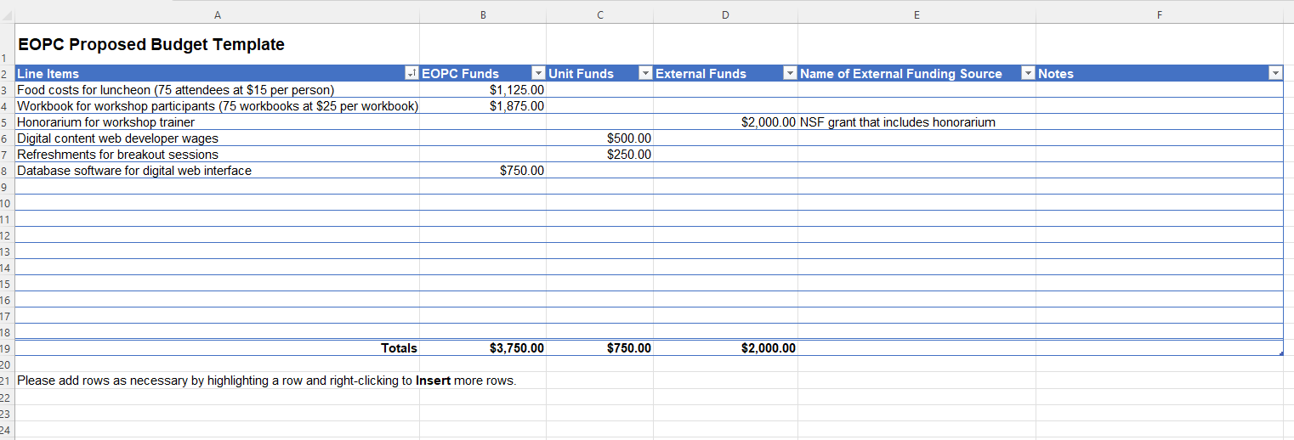
Budget: (cont.)
17
17

Slide 18

Timeline and endorsements:
Timeline: A timeline should describe the major project milestones, program components, and address how and when the program will be delivered.
Endorsements: Affirm support of unit executive, immediate supervisor, and budget officer.
18
18

Slide 19

Review of proposals:
Review teams
Review process
Full funding,
partial funding,
conditional funding,
no funding
19
19

Slide 20

Program evaluation:
Funded programs must submit an evaluation approximately six weeks following the conclusion of the funding period.
The link to the evaluation form can be found on the EOPC SharePoint site under “Resources for EOPC funded programs.”
20

Slide 21

Program evaluation: (cont.)
Evaluations should include:
  Description of actual program participants
  Narrative and rationale describing any changes that were made to the program goals, objectives and/or assessment
  “Yes” or “No” as to whether each objective was met
  Comment on any objectives that were not met
  Total number of quantitative and qualitative outcomes
  Budget reports including proposed expenses and actual expenditures (endorsed by your financial officer)
  Assessment report(s)
21
21

Slide 22

Deadlines/assistance for proposal writing:
Summer 2023
Academic year 2023-24
Submissions – Friday, December 9, 2022
Review date – Thursday, January 19, 2023
Award notification by EOPC – Friday, March 3, 2023
Program evaluations – Friday, September 15, 2023
Submissions – Friday, January 20, 2023
Review date – Wednesday, February 22, 2023
Award notification by EOPC – Friday, April 7, 2023
Program evaluations – Friday, June 28, 2024
Program evaluations are due within six weeks of the program’s completion.
The Office of the Vice Provost for Educational Equity will review proposal drafts to provide feedback in advance of submission deadlines as time and capacity permits.
22
22

Slide 23
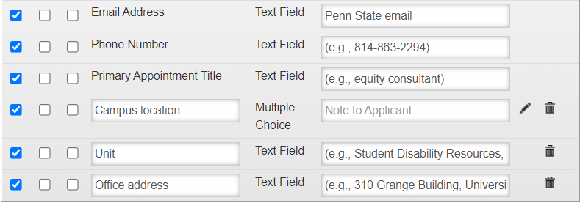
Summer and academic year EOPC proposals are now
located in InfoReady – here are some requirements.
Summer 2023
23
23

Slide 24
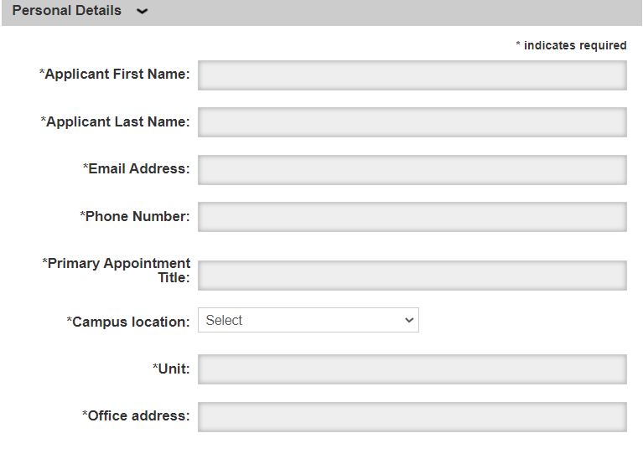
EOPC Proposal Review
Summer 2023
24
24

Slide 25
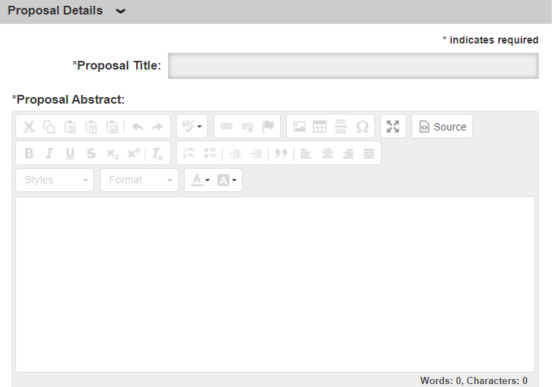
Proposal Details
Summer 2023
25
25

Slide 26
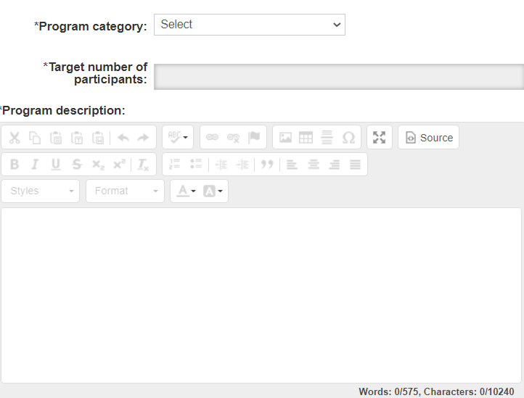
Proposal Details (cont.)
Summer 2023
26
26

Slide 27
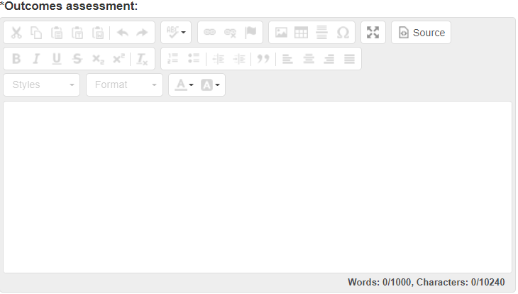
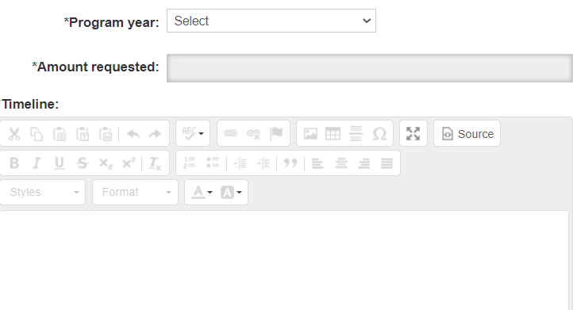
Proposal Details (cont.)
Summer 2023
27
27

Slide 28
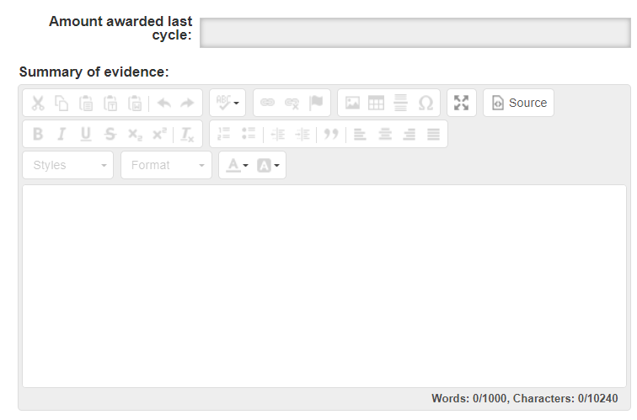
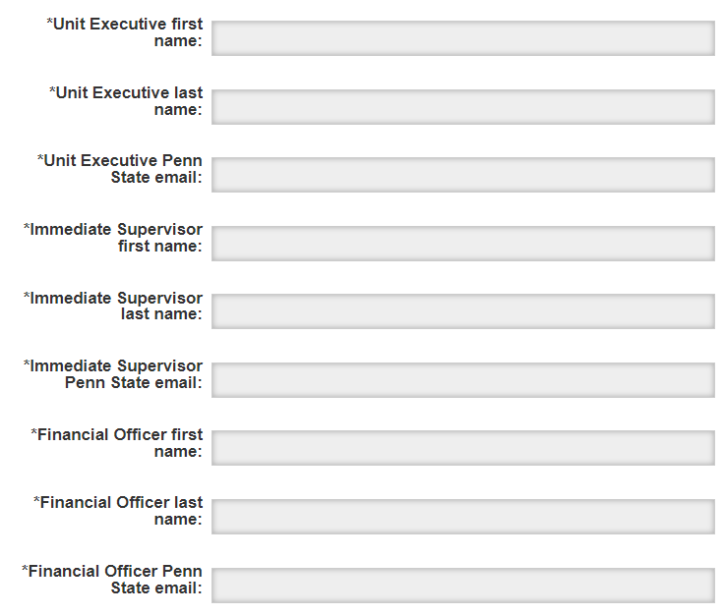
Proposal Details (cont.)
Summer 2023
28
28

Slide 29
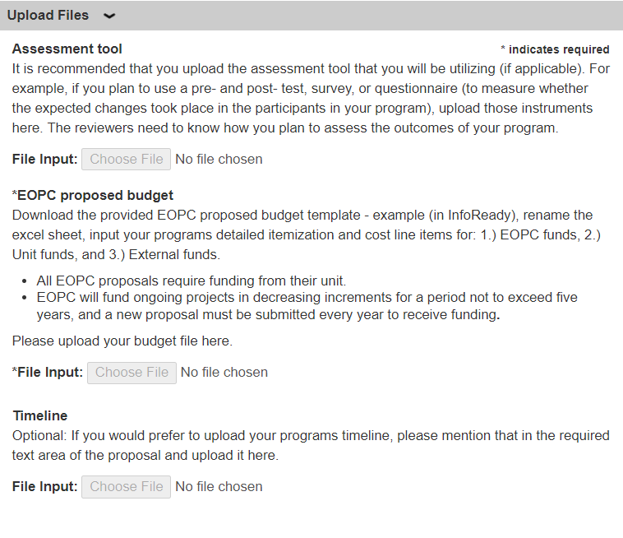
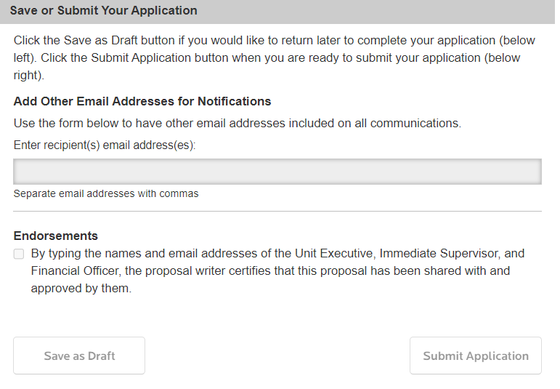
Proposal Details (cont.)
29
29

Slide 30
Contact me:
Please feel free to reach out to me using my email below or at eopc@psu.edu.
Sheila Dianne Barlock
EOPC Administrator
sdc108@psu.edu
30

