Slide 1

Equal Opportunity Planning Committee (EOPC) Proposal Reviewer Training
Sheila Barlock, M.Ed.
Equity Consultant
Office of the Vice Provost for Educational Equity
1

Slide 2
Learning objectives:
As a result of today’s training, participants will be able to:
  Describe the mission of EOPC
  Locate EOPC proposal writing resources
  Summarize the components of the EOPC proposal
  Differentiate between funding decisions
  Critique EOPC proposals
2

Slide 3
Equal Opportunity Planning Committee (EOPC):
Promotes greater equity for historically underrepresented/underserved groups
Oversees the allocation of institutional funding
Provides seed funding
All EOPC proposals should align with University strategic planning efforts
  For more information visit: http://strategicplan.psu.edu or http://www.opa.psu.edu
3
3

Slide 4
EOPC overview:
Sheila Barlock, Equity Consultant​
Proposal form is available on our website: http://equity.psu.edu/eopc ​
The EOPC website contains tips, templates, deadlines, and examples​
Sheila (sdc108), or eopc@psu.edu​
EOPC proposal resources EOPC SharePoint site​
Request to be added to our EOPC listserv​
Compliance with University regulations (AD91)​
4
4

Slide 5
Funding categories:
Campus climate
Curriculum
Faculty and staff recruiting
Faculty and staff retention
Leadership development
Student recruiting
Student retention and graduation
Organizational change
5
5

Slide 6
Funding guidelines – NOT funded by EOPC:
Gifts, “giveaways,” and prizes
T-shirts, buttons, balloons, and other such items
Conferences where travel is required
Research projects, computer hardware, art, or library collections
Wages/honoraria for 12-month full-time Penn State faculty/staff or graduate assistantships (EOPC will consider funding graduate and/or undergraduate students on wages)
Scholarships
Instructor salaries for Penn State courses where tuition is charged
Cannot be funded for both EOPC and Campus Access and Success Grants (CASG)
6
6

Slide 7
Review teams:
Team leader
3-4 reviewers per team
3-4 proposal reviewed per team, depending on number of submissions
Each reviewer will submit their notes and reason for funding decision to the team leader to compile
Provide justification for funding decisions – will be included in notification letters
7
7

Slide 8
Components of the EOPC proposal form:
You can view the EOPC proposal form here
Contact information
Abstract
Program description
Assessment
Proposed budget
Timeline
Endorsements
8
8

Slide 9
EOPC proposals should address:
Need: The need should be clearly stated. The need should align with EOPC's mission and should address a connection to the unit or University's strategic plan.
Program description: The proposal should contain a description of the activities or initiatives that will take place.
Goals: The goals should be explicitly stated.
Learning outcomes: The learning outcomes should operationalize the goals and answer what participants should learn from the program or initiative.
Assessment: The proposal should include a way to measure learning and impact of the program.
9
9

Slide 10
EOPC proposals should address:
Timeline: Major milestones of the program should be outlined. ​
Renewal proposal: If the proposal is a renewal, the proposal should contain an overview of what was learned: challenges, successes, and improvements to be made.
Budget: The budget should meet the EOPC budget guidelines. The proposed budget should include funding from the unit.
Endorsements: All EOPC proposals should contain endorsements from the unit executive, immediate supervisor, and financial officer.
10
10

Slide 11
Assessment:
Assessment should address:
  What is the learning opportunity (activity) and what should be learned?
  How should participants be changed as a result of attending or participating in this program or initiative?
  How is the learning going to be measured?
11
11

Slide 12
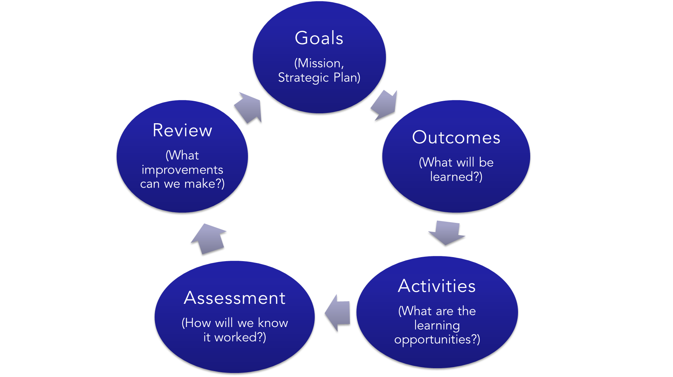
12
12

Slide 13
EOPC proposal evaluation:
Each reviewer is expected to complete an evaluation of the proposals they are assigned.
  The feedback you provide in this form will be used in funding notification letters
  Provide clearly written feedback
Click here to view the EOPC Proposal Evaluation
13
13

Slide 14
Funding options:
Full funding, no conditions
Funding with conditions
Partial funding
Partial funding with conditions
No funding
14
14

Slide 15
Funding notifications:
If the review team chooses to fund with conditions, the proposal submitters will have a deadline to resubmit their proposal reflecting any suggested changes.
If there are conditions that the review team wants the proposal submitter to meet before receiving funding, it is crucial that the review team clearly articulates those conditions.
Proposal submitters will have access to the Equity Consultant for any assistance or clarification as they revise their proposal.
15
15

Slide 16
About "no funding":
While no funding is an option, please consider the following:
Can the proposal be revised?
Proposal submitters can work with the Equity Consultant to revise any part of their proposal.
16
16

Slide 17
Reviewing via Zoom:
Start in the same Zoom room for a welcome.
Each review team will break off in their own Zoom room.
Equity Consultant will be available for questions.
17
17

Slide 18
Reviewer cheat sheet:
Did they articulate a need for the program?
Who is the intended audience?
Is there an alignment with the University's or unit's strategic plan?
Did the proposal contain goals?
Are the learning outcomes/objectives clearly written and measurable?
Is there a way to measure the impact of the program (an assessment instrument)?
Does the budget adhere to EOPC guidelines, and are they being good stewards of University funds? Is there financial support from the unit?
Is the proposal endorsed?
Is no funding an appropriate decision, or can the proposal be revised?
18
18

Slide 19
Want to continue the conversation?
Please contact me via email:
Sheila Barlock
Equity Consultant
Office of the Vice Provost for Educational Equity
sdc108@psu.edu, eopc@psu.edu
19
19

