Slide 1


Slide 2
Military Deployment 101
Military Obligations and Penn State Policies & Guidance
Faculty and Staff
Renée Thornton-Roop
Eugene McFeely
Steve Dolphin
Notes:
Penn State Veteran Ally Training
Who: Penn State Professors, Instructors, Academic Advisors and Support Staff
What: Discussion on military deployments, related Penn State policies & guidance, and course accommodations.
When: 1 Apr 2026, 1200-1300
Where: Zoom
Format: Zoom
POC: Renee Thornton-Roop
Presenters: Renee Thornton-Roop, rat14@psu.edu; Eug McFeely, elm101@psu.edu; Steve Dolphin snd10@psu.edu

Slide 3












Introductions
Renée Thornton-Roop
  Senior Director, Office of Veterans Programs
  Education Equity
Eugene McFeely
  Senior Director, Veterans Affairs and Services
  Office of the President
Steve Dolphin
  Assistant Director Programming & Outreach, Office of Veterans Programs
  Education Equity
U.S
State
Army
Marine
Navy
Air Force
Space Force
Coast Guard
Penn State
  "GI Bill®” is a registered trademark of the U.S. Department of Veterans Affairs (VA). More information about education benefits offered by VA is available at the official U.S. government website at www.benefits.va.gov/gibill.

Slide 4
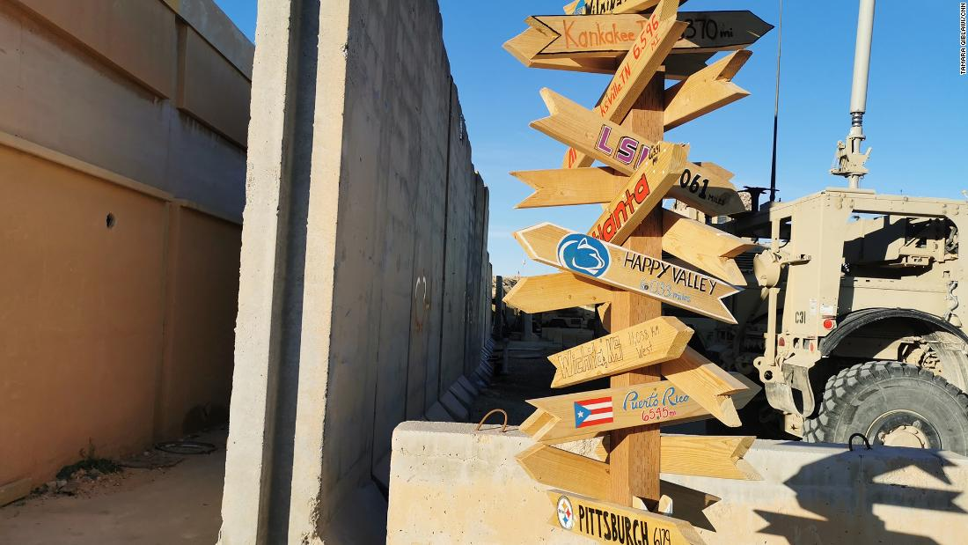

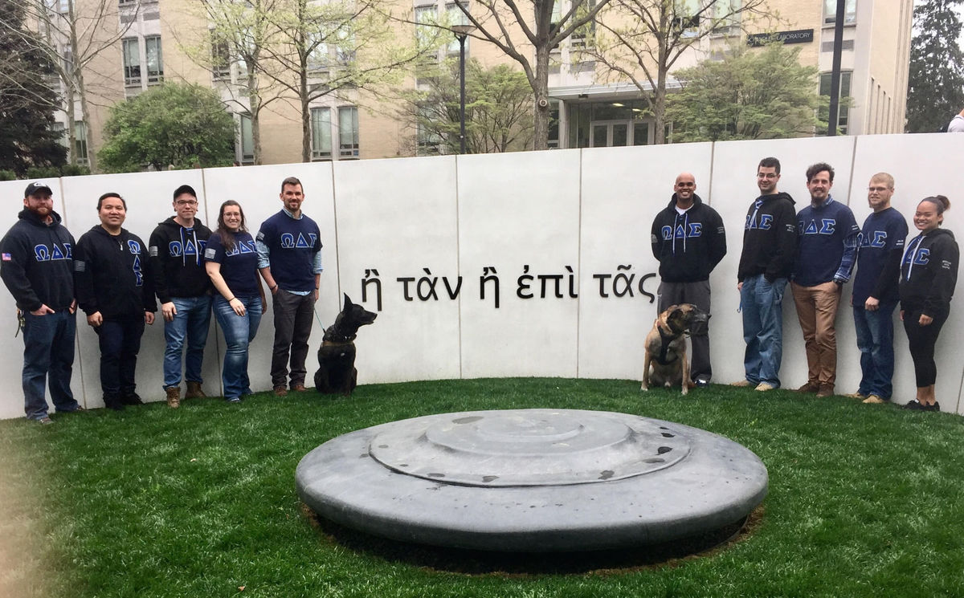




Overview
Military Obligations and Student Scenarios
Deployment 101 and University Notification
Penn State Policies and Guidance
The Process and Military Education Benefits Impact
Ombudsman as a Resource

Slide 5
Objectives
Understand military obligations and activation/deployment scenarios
Understand the impact of deployments on the service member and their families
Understand Penn State Policies and AAPPM Guidance on deployments
Understand the process of supporting students with military obligations
Know how to involve/leverage the military-connected student ombudsman to support resolution of deployment issues

Slide 6


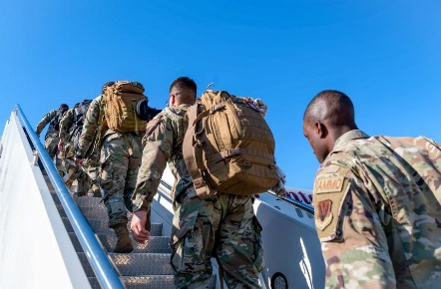
Interruptions to Academic Progress
(Types of Military Obligations)
Temporary Duty (TDY) – 7 days to 6 months
  Short to medium-term obligation away from primary duty location
  Usually, no prep time required before date
Permanent Change of Station (PCS) – 4 to 6 months
  Military household move to different location (city, state, or country)
  Prep time required well before and after move date
Training – 7 days to 6 months
  Home unit or special location (city, state, or country)
Activations – Crisis/Mission Dependent
  Affects National Guard and Reserve
  World-wide (CONUS or OCONUS)
  Prep time required before and after activation
Deployments – Crisis/Mission Dependent (14 days to 365+ days)
  World-wide (CONUS or OCONUS)
  Prep time required well before and after deployment

Slide 7
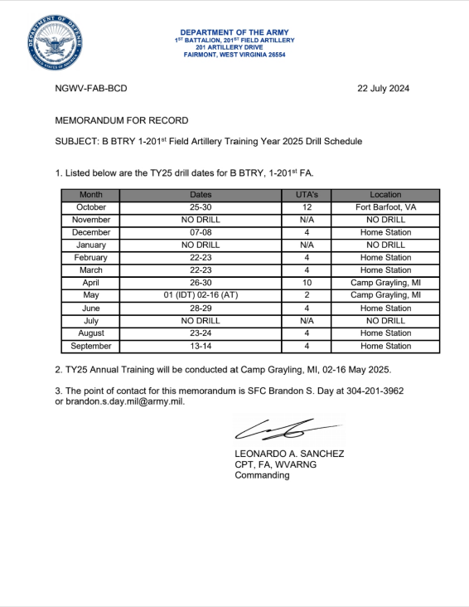
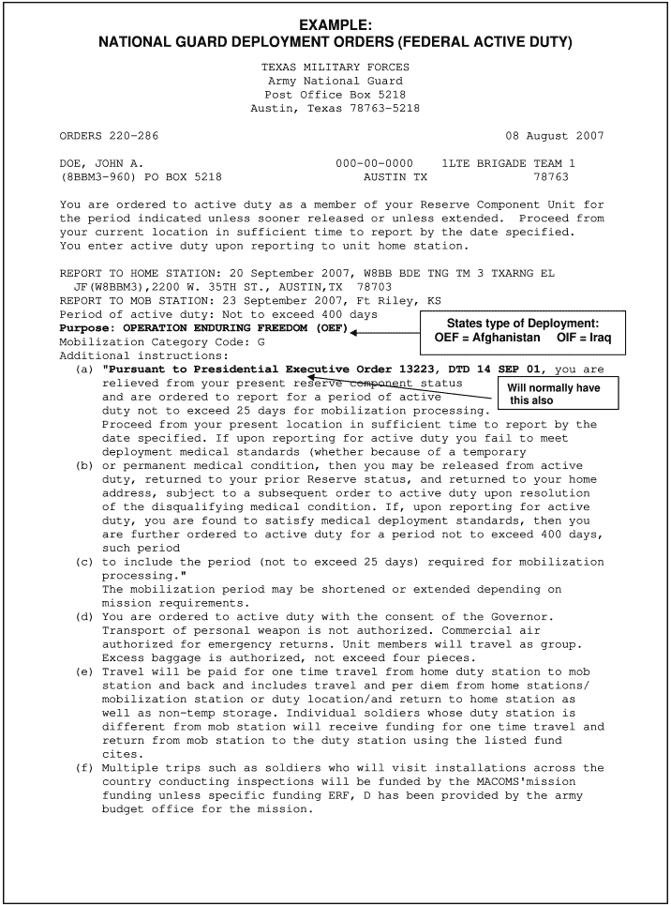
Interruptions to Academic Progress
(Military Obligation Notice)
Military obligation can either be pre-planned or short/no-notice
Pre-Planned
  Training or Guard/Reserve Unit Drill Schedule
  Planned rotational deployments or military moves
  Student knows about in advance
    Typically, before the semester begins
  Long range military orders available ahead of time
Short/No-Notice
  Pop-up training or military moves
  National or state emergencies
  Unplanned deployments or placed on Prepare to Deploy (PTD) Orders
  Usually happen with very little or no notice
  Verbal orders or military orders are available after deployment begins

Slide 8
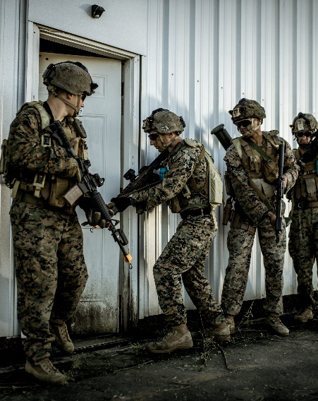
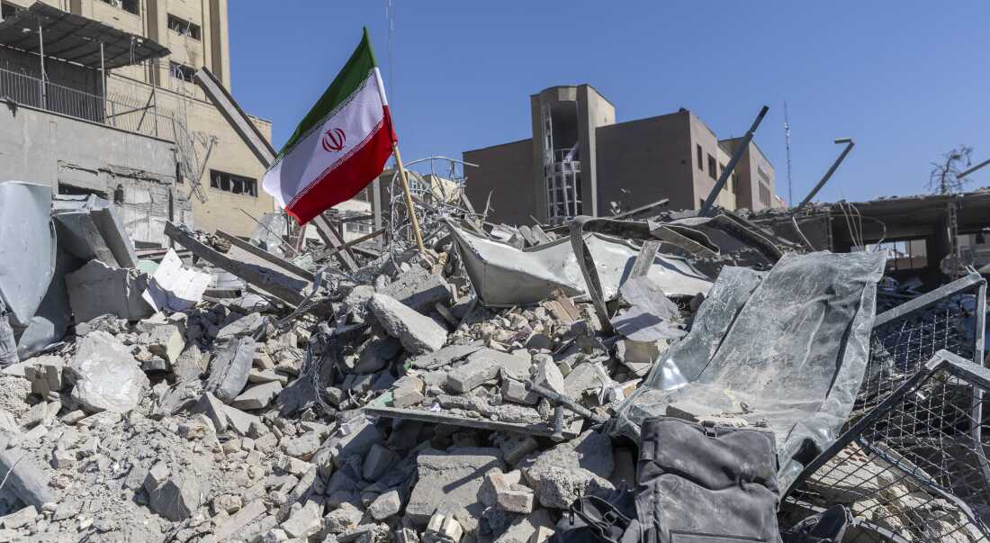
Military Student Scenarios
National Guard annual training requirements
  Drill/training dates posted annually in advance for the year
Deployment Cycles
  Unit has advance notice of future deployment rotation/activation
Activation for State emergencies
  COVID, natural disasters, support to law enforcement etc.
Deployment to Overseas Crisis
  Current Iran situation
  Prepare to Deploy (PTD) vs Deploy

Slide 9
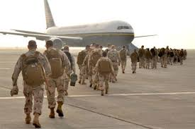

Deployment 101
Duration
  Ranges from 14 days to 365+ days
  Duration can be open ended
  Typical duration is 6–12-month for past 20 years
Frequency
  Redeploy after a specified dwell period
  Deploy multiple times during service
Location
  CONUS or OCONUS
  Combat or Non-Combat
Ops Tempo
  Dependent on mission requirements
  Normally need to scale back non-deployment engagement/activity
  May not have access to communications or internet
Impact
  Major impact on life
  Break or slowing of academic pursuit
  Affects entire family…pets too!
Notes:
Emotional cycle of deployment
Savych, B. (2009). Effects of deployment on spouses of military personnel. Humanities and Social Sciences, 3295.

Slide 10

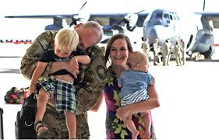
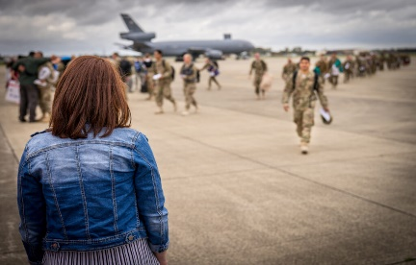
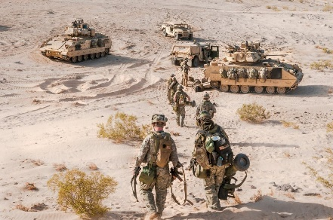
Deployment 101
(Phases of Military Deployment)
Pre-Deployment
3-6 months out
Gone even though at home
Getting affairs in order
Anticipation of separation
Weeks to a month
Honeymoon period
Loss of independence
Need own space
Reintegration
Post-Deployment
Deployment
3-5 Days
Overwhelmed
Very emotional
Redeployment
Sustainment
3-5 days to a month
Anticipation and excitement
Apprehension
Delays and false starts
6-12 months long
New routines
New responsibilities
Danger and worry
Power through and resiliency
Notes:
Emotional cycle of deployment
Savych, B. (2009). Effects of deployment on spouses of military personnel. Humanities and Social Sciences, 3295.

Slide 11
Faculty and University Notification
(Student’s Obligation – Pre-Planned)
Pre-Planned military obligations – Student notified prior to semester
Option 1: Schedule to deconflict from known event
  Military Withdrawal and Military LOA until military obligation complete
Option 2: Continue planned coursework with accommodations
  Coordinate with professor/instructor before class begins but NLT end of first week of class (normal drop/add)
  Mutually agreeable accommodations in writing
    Makeup work, work ahead, hybrid attendance etc.
  May have to drop non-compatible courses
Option 3: Continue coursework at a reduced rate of pursuit
  Only schedule compatible class
  Only schedule number of credits that deployment tempo/connectivity will support
Ombudsman as a resource

Slide 12
Faculty and University Notification
(Student’s Obligations – Short-Notice)
Short-Notice military obligation – Student notified after semester starts
  May or may not have substantiating documentation before university departure
Notify faculty immediately
  Coordinate with professor/instructor to determine if course can be continued
Option 1: Continue coursework with mutually agreeable accommodations in writing
  Makeup work, work ahead, hybrid attendance, deferred grade etc.
  May or may not be able to negotiate accommodation or university actions before departure
Option 2: Military Drop (MD) non-compatible courses
  Allows academic pursuit at a reduced rate
  Initiate actions with registrar immediately
  May or may not be able to complete university actions before departure
Option 3: Military Withdrawal (MW)
  Deployment circumstance and course compatibility may require withdrawal from all courses
  Initiate actions with registrar immediately
  May or may not be able to complete university actions before departure
Ombudsman as a resource
Notes:
Verbal Orders of the Commander (VOCO) are military travel authorizations issued without advance written orders, typically as a last resort due to emergencies or system errors. They require immediate, written confirmation and must be authorized by a commander before travel begins to ensure pay and liability coverage.

Slide 13
Penn State Policies & AAPPM Guidance
(Overarching Objective & Spirit of Intent)
Our policies and procedures are designed to accommodate military students to the greatest degree possible, avoiding negative academic or financial consequences, while minimizing interruptions in their academic progress and easing their return to academic pursuits once their military obligations are complete.
Notes:
To allow the student to meet their military obligation while ensuring that they are not penalized academically or financially for situations outside of their control, and if possible, to not have a break in their academic pursuit.

Slide 14
Penn State Policies & AAPPM Guidance
(Applicable Students)
U.S. Armed Forces active-duty service members or activated reserve-component service members (Guard or Reserve),
and some apply to
those who are dependent spouses or dependent domestic partners of the active-duty service member or activated reserve-component service member as well
Notes:
To deny accommodation requests were allowed, professor/instructors must provide a reason why course content objects cannot be met if an accommodation is given.

Slide 15
Penn State Policy
(Military Service Absences and Deployments)
42-27 Class Attendance (ref E-11)
  Short-term absence
  Military service legitimate reason to make up work for missed class and request for accommodation
  Ability to appeal to Director of Academic Affairs or Associate Dean of college
56-30 Withdrawal (ref J-1 & J-3)
  Applies to service members and spouse/domestic partner
  Full Military Withdrawals (MW), or
  Partially cancelled schedule via Military Drops (MD)
    Allows service member to continue partial academic pursuit without a break
56-70 Leave of Absence (ref J-2 & J-3)
  Applies to service members and spouse/domestic partner
  Told to reference to J-2 and J-3 for action
Notes:
42-27
Instructors also should provide, within reason, the opportunity to make up work for students who miss classes for other legitimate but unavoidable reasons. Legitimate, unavoidable reasons are those such as illness, injury, military service, family emergency, or religious observance. Again, it should be recognized that not all work can be “made-up” and that absences can affect student performance in a class.
Due to the potential for academic or financial hardship for military members, for those students providing verified orders, a denial of accommodation may be appealed to the Director of Academic Affairs of the campus or the appropriate associate dean of the college (or DUS) in which the student is enrolled. When the student is unable to make arrangements with instructors for unexpected orders requiring a short term absence, or upon denial of an appeal, the Director of Academic Affairs or Associate Dean will notify the Registrar’s Office of the administrative cancellation of the course(s) and 100% of the tuition for the course(s) will be refunded to the student. For orders requiring absences lasting longer than two weeks, students may pursue a military withdrawal directly through the Registrar’s Office.
56-30
Active-duty service members or activated reserve-component members of the U.S. Armed Forces (not a contractor or civilian working for the military) and/or spouses/domestic partners of active-duty members or activated reserve-component members who are ordered by their military service to relocate or deploy and, as a result, are unable to complete a schedule of courses for a given semester may request a Partially Cancelled Schedule. Full military withdrawals will be considered in cases where the student is unable to complete their full schedule of courses. This type of withdrawal will be in accordance with the policies and procedures for withdrawal given previously in Section 56-30. A Partially Cancelled Schedule will be considered in cases where the student is only able to continue with a portion of their scheduled courses as a result of their military relocation or deployment. In the case of a partially cancelled schedule, students will be allowed to drop a portion of their scheduled courses after consulting their college/academic unit, and they will maintain their status in the university as a degree candidate
56-70
Told to reference to J-2 and J-3 for action

Slide 16
Penn State AAPPM
(Military Service Absences and Deployments)
E-11 Class Attendance
  Short-term absence for military service – two weeks or less
  If unable to make accommodations, admin cancel class and tuition refunded
J-1: Withdrawal and J-2: Leave of Absence
  Told to reference J-3
J-3: Military leave of Absence, Withdrawal, and Late Drop
  U.S. Armed Forces only
  Short-term absence
    As stated in E-11
  Military Leave of Absence (MLOA)
    Available before semester starts and before student begins attending class
    Can be up to 5 years in length
Notes:
E-11 Para 6.
Students who provide verified orders requiring a short-term absence for military service and are unable to make arrangements with instructors for making up missed evaluative events are eligible for administrative cancellation of the course(s) and 100% of the tuition for the course(s) will be refunded to the student. These students should notify the Director of Academic Affairs or Associate Dean of their college or campus who will notify the University Registrar's Office. For orders requiring absences lasting longer than two weeks, students may pursue a military withdrawal directly through the University Registrar's Office.
J-1 & J-2
Military Withdrawal for U.S. Armed Forces active-duty service members or activated reserve-component service members (Guard or Reserve), and/or those who are dependent spouses or dependent domestic partners of the active-duty service member or activated reserve-component service member is covered under J-3 U.S. Military Leave of Absence, Withdrawal, and Late Drop.
J-3
Context: Active-duty and reserve-component service members are committed to serve our nation with a world-wide deployment responsibility and are subject to changes of assignment/duty location and military activation, all of which can occur with little or no notice. The dynamic nature of their national service can cause interruptions in their academic progress which in turn jeopardizes their ability to pursue academic programs at Penn State. Our policies and procedures are designed to accommodate these students to the greatest degree possible, avoiding negative academic or financial consequences, and easing their return to academic pursuits once their military obligations are complete.
Applicability: Only students who are baccalaureate or associate degree candidates may use this process to file for a Military Leave of Absence, a Military Withdrawal or a Military Drop. These policies and procedures apply to U.S. Armed Forces active-duty service members or activated reserve-component service members (Guard or Reserve), and/or those who are dependent spouses or dependent domestic partners of the active-duty service member or activated reserve-component service member. They do not apply to civilian contractors, civilians working for the DoD, nor for service to other nations. However, Penn State recognizes the significant demands placed on international students whose studies are interrupted by mandatory military service in their home countries, and this is addressed explicitly in J-2, Leave of Absence.
Documentation of Military Service Obligation: A student's military service obligation can include a military permanent change of station (PCS), temporary duty assignment (TDY), reserve-component activation, or deployment. Students must provide proof of the military obligation by providing:
a. a copy of military orders, and when applicable,
b. proof of dependency to the militarily obligated service member (spouse/domestic partner only).
Documents substantiating military obligation must be provided to the Office of the University Registrar as soon as possible but no later than 5 PM on the last day of classes.
Short-term Absence: Students who provide verified orders requiring a short-term absence for military service and are unable to make arrangements with instructors [see E-11] for making up missed evaluative events are eligible for administrative cancellation of the course(s) and 100% of the tuition for the course(s) will be refunded to the student. These students should notify the Director of Academic Affairs or Associate Dean of their college or campus who will notify the Office of the University Registrar. For orders requiring absences lasting longer than two weeks, students may pursue a military leave of absence, a military withdrawal, or a military drop.
Military Leave of Absence (MLOA): Students who have yet to begin classes when their military service obligation becomes known are eligible to be placed on MLOA status for a period not to exceed five (5) years.
a. The MLOA provides the same protections as a standard LOA (see Policy J-2) but is available for a greater time limit.
b. If students have yet to begin the semester, their schedules are cancelled, and they are placed on MLOA.
c,. If students enroll and do not attend any classes due to military obligation, administrative cancellation can be used to place the student on MLOA.
d. If there is an MLOA, this is indicated on the student's transcript.
e. MLOA is not available to students who have begun attending classes for that semester.
f. If there is an extension of military obligation, students have the option of continuing the MLOA beyond the initial period but not to exceed five (5) years.
To request an MLOA or request an extension, students should contact the Office of the University Registrar.

Slide 17
Penn State AAPPM
(Military Service Absences and Deployments)
J-3: Military leave of Absence, Withdrawal, and Late Drop (cont.)
  Military Withdrawals (MW)
    Full withdrawal from all courses with no financial or academic penalty
    Student accounts (email etc.) will remain active and re-enrollment will be automatic upon request after obligation is complete
  Military Drops (MD)
    Used when able to continue some courses with instructor allowed accommodation
      Complete compatible courses remotely while engaged in military service and MD the rest
    Allows student to maintain partial schedules and avoid a break in academic pursuit
    Must consult their college/academic unit to MD
    Student reserve the option to request deferred grades (DF) for course they continued, and
    Student reserve the option to MD the courses they continued until last day of class
    MD has with no financial or academic penalty
Notes:
J-3 (cont)
Military Withdrawal (MW) and Military Drop (MD): Students who have begun classes when their military obligation commences can fully withdraw from all their courses using a Military Withdrawal (MW) or continue with a reduced course load using a Military Drop (MD) for a portion of their courses. The MD is intended to provide students maximum flexibility to complete courses by maintaining a partial schedule when faculty can adjust course delivery to accommodate distance delivery. An MD or MW will not be counted toward the Course Repeat Policy (C-7).
a. Students who have begun classes and must take a full break from their studies must be withdrawn. This Military Withdrawal is indicated on the transcript. For the period of their military orders, students' accounts will remain active and re-enrollment will be automatic by sending an email request to the Office of the University Registrar. Students will re-enroll with their status in the university as degree candidates in their original program requirements.
b. Students wishing to maintain partial schedules will be advised to work with individual faculty to evaluate the opportunities to complete courses remotely while engaged in military service.
c. Students may MD a portion of their scheduled courses after consulting their college/academic unit.
d. All courses that are not completed with an earned grade will be recorded as MD, which indicates the action was due to military obligation on the student's transcript.
e. Students who continue in courses retain the option of requesting a deferred grade (DF) following current policy.
f. Students who decide to continue in a course may use the MD option until 5 PM on the last day of classes.
g. Students cannot MD for all courses in a semester. Instead, students who must fully withdrawal are required to utilize the MW process.
h. Students who complete at least one credit in a semester but do not wish to continue the following semester must apply for a Military LOA. Otherwise, their student record will be discontinued.
i. Students on MLOA or MW may return to their studies remotely while continuing to meet their military obligation by contacting the Office of the University Registrar to re-enroll. Students should contact the Office of the University Registrar to have their status updated and will need to keep the Office of the University Registrar informed on their plans for subsequent semesters.
Financial Considerations: Financial policies for Military Leaves of Absence (MLOA), Military Withdrawals (MW), and Military Drops (MD) will ensure that:
a. Students receive a full tuition refund for those courses that will not be completed due to military obligation. Tuition will be recalculated to include only continued courses.
b. If a student has on-campus housing and/or a meal plan, they will receive a full refund for housing and any unused meal points will be refunded.
c. Students will maintain their university access account/email at no cost to the student.
d. Students will be guaranteed the ability to return under original term of enrollment with no reenrollment or other additional fees.
e. Students will be advised by the Financial Aid Office of actions required to defer loan(s) repayments based on active military duty obligations.

Slide 18
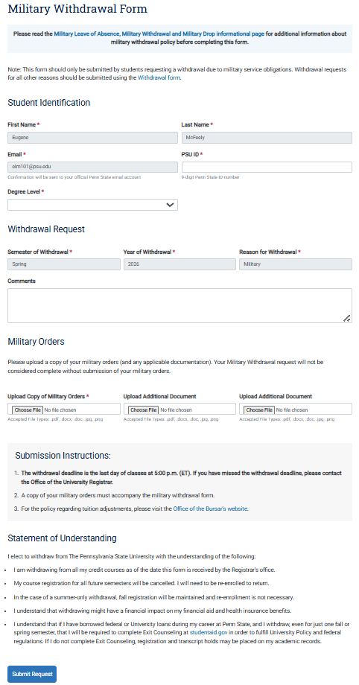
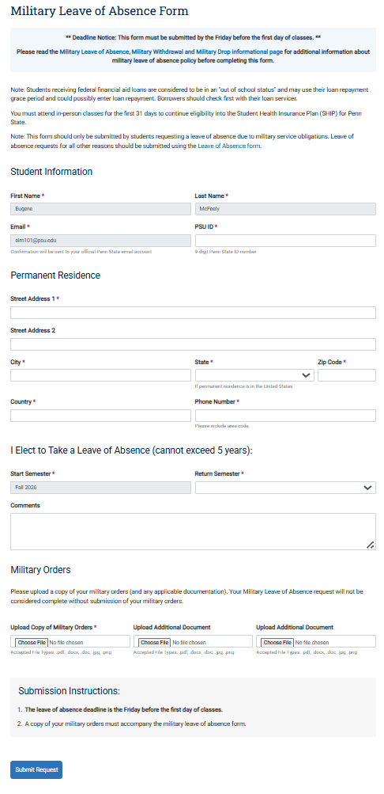
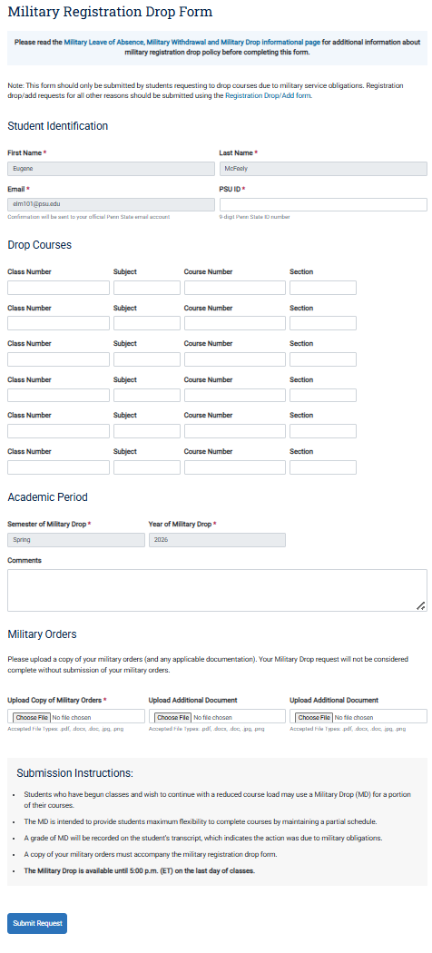
The Process
(Accommodations and Military Drops/Withdrawals/LOA)
https://www.registrar.psu.edu/enrollment/leaving/military-leave-absence-withdrawal-drop.cfm
Through Registrar Office
  Military Withdrawal
  Military Leave of Absence
  Military Drop
Fill in the “Comments” section with details!!!
  Reason you are requesting action
  Military obligation dates
  Impact the obligation has on your ability to continue academic progress, complete semester, or complete course
  Helps expedite your request!
Notes:
https://registrar.psu.edu/student-forms/military-withdrawal/
https://registrar.psu.edu/student-forms/military-leave-absence/
https://registrar.psu.edu/student-forms/military-drop/

Slide 19
Impact on Military and VA Benefits
(Federal Tuition Assistance)
Students using Federal Tuition Assistance (FTA)
Most service branches (Army, Air Force, Navy, Marines, Space Force) allow a full or partial waiver of TA repayment.
Questions about FTA? Contact Veterans Affairs and Services (sdvas@psu.edu)

Slide 20
Impact on Military and VA Benefits
(Pennsylvania Educational Assistance Program)
For PA National Guard students using the Educational Assistance Program benefits (EAP), their benefits are protected.
Students with questions about EAP should contact their assigned unit or the PA National Guard Education Services Office: https://www.pa.ng.mil/education/Education-Assistance-Program/

Slide 21
Impact on Military and VA Benefits
(GI Bill®)
Students using GI Bill® may incur debt due to military drop/withdrawal:
Tuition & Fees
  The VA may not create a debt for the student, but for the university.
  If the school refunds tuition to VA, the payment is adjusted based on last date of attendance.
Monthly Housing Allowance (MHA)
  Paid only through the last date of attendance.
  If the student was paid beyond that date, VA may create an overpayment for MHA resulting in a debt to the student.
Books & Supplies Stipend
  Usually no repayment required if withdrawal is due to qualifying active duty.
GI Bill®” is a registered trademark of the U.S. Department of Veterans Affairs (VA). More information about education benefits offered by VA is available at the official U.S. government website at www.benefits.va.gov/gibill.

Slide 22
Impact on Military and VA Benefits
(GI Bill® Help)
Students using GI Bill® may incur debt due to military drop/withdrawal.
Please refer students to the
Office of Veterans Programs
if they are using VA Educational Benefits!
814-863-0465 or ovp@psu.edu

Slide 23
Office of Veterans Programs as a Resource
Identify and explain Penn State policies and procedures to accommodate specific training/deployment/activation scenarios.
Research and advise students regarding impact on GI Bill® and provide referrals for review of federal aid.
Assist in identifying and accessing available resources for student and their family as applicable.
Office of Veterans Programs — ovp@psu.edu — (814) 863-0465

Slide 24
Ombudsman as a Resource
Questions about activations, deployments, or military accommodation requests
Understanding the military burden the student is trying to convey
Discuss options available to student based on their military circumstances
  Military accommodations
  University accommodations
Help with verifying source of accommodation requests
Outreach to the student
Eugene McFeely — elm101@psu.edu — (814) 865-5676
Notes:
To deny an accommodation requests were allowed, professor/instructors must provide a reason why course content objects cannot be met if an accommodation is given.

Slide 25
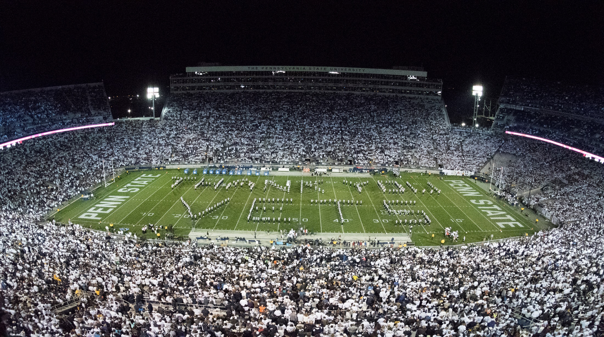
Questions
Putting “THANK YOU FOR YOUR SERVICE” Into Action!
Notes:
Penn State Military Appreciation Football Game 2018

Slide 26
Resources

Slide 27

Military-Connected Student Programs and VA Education Benefits
Renee A. Thornton-Roop
Senior Director, Office of Veterans Programs
814-867-4160
rat14@psu.edu
Education Equity
Office of Veterans Programs
Ritenour Building #138
371 Pollock Road
University Park, PA 16802-6701

Slide 28
Military-Connected Student Ombudsman
Eugene L. McFeely
Senior Director, Veterans Affairs and Services
814-865-5676
elm101@psu.edu
Office of the President
Veterans Affairs and Services
Ritenour Building #147A
371 Pollock Road
University Park, PA 16802-6701

Slide 29
Military-Connected Student Outreach Coordination
Steve Dolphin
Assistant Director of Programming & Outreach
814-863-0465
snd10@psu.edu
Education Equity
Office of Veterans Programs
Ritenour Building #146
371 Pollock Road
University Park, PA 16802-6701

